Slide 1
Binary Trees
By
Prof. Amruta Hingmire

Slide 2
Parts of a binary tree
A binary tree is composed of zero or more nodes
  In Java, a reference to a binary tree may be null
Each node contains:
  A value (some sort of data item)
  A reference or pointer to a left child (may be null), and
  A reference or pointer to a right child (may be null)
A binary tree may be empty (contain no nodes)
If not empty, a binary tree has a root node
  Every node in the binary tree is reachable from the root node by a unique path
A node with no left child and no right child is called a leaf
  In some binary trees, only the leaves contain a value

Slide 3
Picture of a binary tree
The root is drawn at the top
a
b
c
d
e
f
g
h
i
j
k
l

Slide 4
Left ≠ Right
The following two binary trees are different:
A
A
B
B
In the first binary tree, node A has a left child but no right child; in the second, node A has a right child but no left child
Put another way: Left and right are not relative terms

Slide 5
More terminology
Node A is the parent of node B if node B is a child of A
Node A is an ancestor of node B if A is a parent of B, or if some child of A is an ancestor of B
  In less formal terms, A is an ancestor of B if B is a child of A, or a child of a child of A, or a child of a child of a child of A, etc.
Node B is a descendant of A if A is an ancestor of B
Nodes A and B are siblings if they have the same parent

Slide 6
Size and depth
The size of a binary tree is the number of nodes in it
  This tree has size 12
The depth of a node is its distance from the root
  a is at depth zero
  e is at depth 2
The depth of a binary tree is the depth of its deepest node
  This tree has depth 4
a
b
c
d
e
f
g
h
i
j
k
l

Slide 7
Balance
a
a
b
c
b
c
e
d
e
f
g
d
f
h
i
j
g
h
A balanced binary tree
i
j
An unbalanced binary tree
A binary tree is balanced if every level above the lowest is “full” (contains 2^{n} nodes)
In most applications, a reasonably balanced binary tree is desirable

Slide 8
Tree traversals
A binary tree is defined recursively: it consists of a root, a left subtree, and a right subtree
To traverse (or walk) the binary tree is to visit each node in the binary tree exactly once
Tree traversals are naturally recursive
Since a binary tree has three “parts,” there are six possible ways to traverse the binary tree:
  root, left, right
  left, root, right
  left, right, root
  root, right, left
  right, root, left
  right, left, root

Slide 9
Tree traversals
BFS
DFS
  INORDER
  PREORDER
  POSTORDER

Slide 10
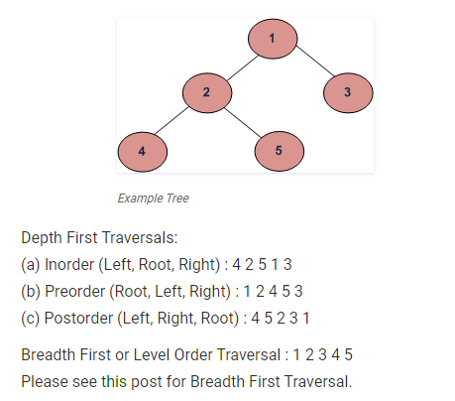
Tree traversals

Slide 11
Preorder traversal
In preorder, the root is visited first
Here’s a preorder traversal to print out all the elements in the binary tree:
void preorder(node * ptr)
/* preorder tree traversal */
{
if (ptr!=NULL) {
cout<<ptr->key;
preorder(ptr->leftchild);
predorder(ptr->rightchild);
}
}

Slide 12
Inorder traversal
In inorder, the root is visited in the middle
Here’s an inorder traversal to print out all the elements in the binary tree:
void inorder(node *ptr)
/* inorder tree traversal */
{
if (ptr!=NULL) {
inorder(ptr->leftchild);
cout<< ptr->key;
indorder(ptr->rightchild);
}
}

Slide 13
Postorder traversal
In postorder, the root is visited last
Here’s a postorder traversal to print out all the elements in the binary tree:
void postorder(node *ptr)
/* postorder tree traversal */
{
if (ptr!=NULL) {
postorder(ptr->leftchild);
postdorder(ptr->rightchild);
cout<<ptr->key;
}
}

Slide 14
Tree traversals using “flags”
The order in which the nodes are visited during a tree traversal can be easily determined by imagining there is a “flag” attached to each node, as follows:
preorder
inorder
postorder
To traverse the tree, collect the flags:
A
A
A
B
C
B
C
B
C
D
E
F
G
D
E
F
G
D
E
F
G
A B D E C F G
D B E A F C G
D E B F G C A

Slide 15
Other traversals
The other traversals are the reverse of these three standard ones
  That is, the right subtree is traversed before the left subtree is traversed
Reverse preorder: root, right subtree, left subtree
Reverse inorder: right subtree, root, left subtree
Reverse postorder: right subtree, left subtree, root

Slide 16
The End

